Slide 1
Panda’s Race
Lesson 5

Slide 2


Review

Slide 3
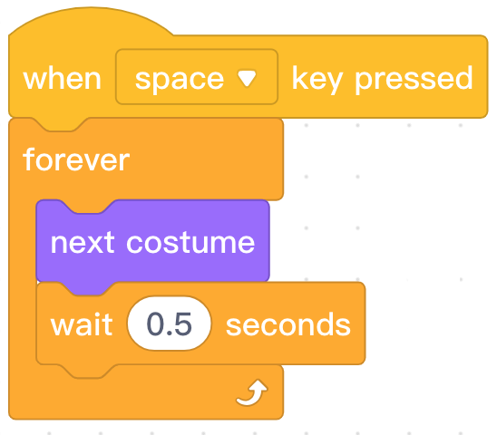
Review

Slide 4
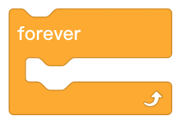

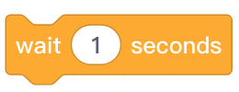
Review
Block | Function
Continuously repeat the blocks nested inside.
When a sprite has multiple costumes, switch the sprite costume to the next costume.
Pause the program and wait the specified amount of time.

Slide 5
Hands On

Slide 6
Moving a Sprite

Slide 7
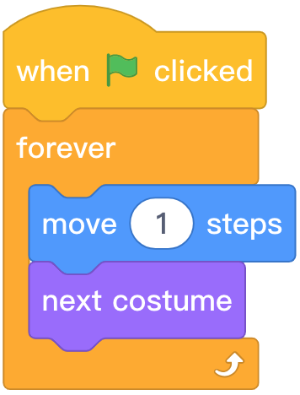


Programming knowledge
Block Area | Block | Function | Example
Move the sprite by 10 steps to the right. The distance can be changed.

Slide 8
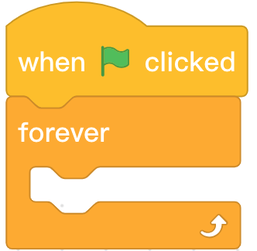
Step 1: Open the mBlock software. Create a new file and click the Sprites tab in the Stage Area to ensure that we are programming the Panda sprite.
Step 2: Find and select the appropriate blocks from the Block Area to create the following program.

Slide 9


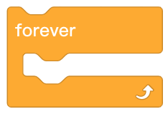
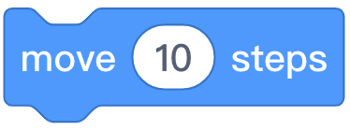
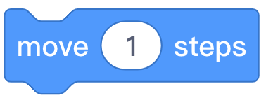
Step 3: Find and select from the Block Area. Click and drag the
block to the Script Area and attach it inside the block. Change the number of steps to “1”.

Slide 10



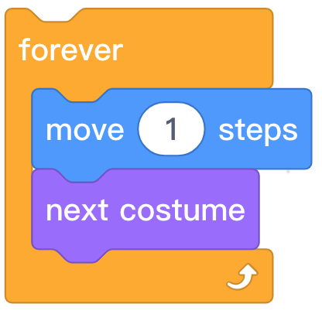

Step 4: Find and select from the Block Area. Click and drag the
block to the Script Area and attach it beneath the block.
Step 5: Click the in the Stage Area to run the program and observe Panda walking.

Slide 11
Step 6: Describe where on the stage Panda is located after the program runs for a little while.
Step 7: Click the in the Stage Area to stop the program. Click the to run the program again.
Step 8: Describe the problem with the current program.

Slide 12
Positioning a Sprite

Slide 14
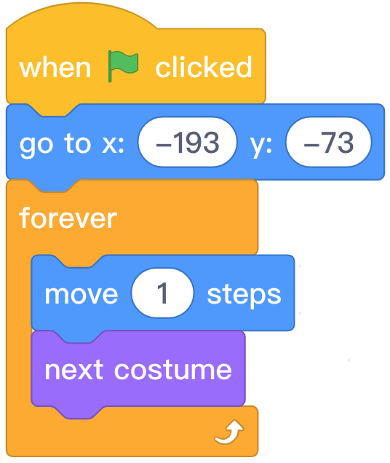


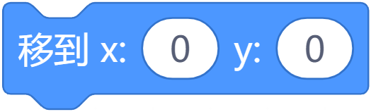
Programming Knowledge
Block area | Block | Function | Example
Set a specific position for a sprite.
The X and Y coordinates are used to specify the position of the sprite in the horizontal and vertical plane and can be adjusted freely.

Slide 15
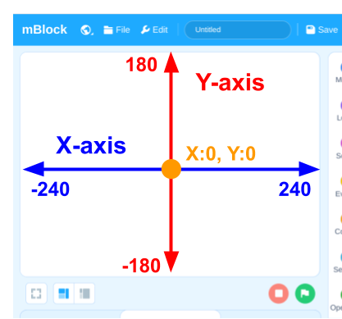

Slide 16
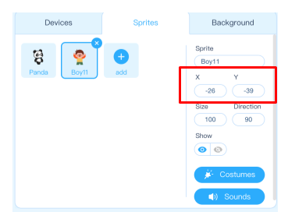
Step 1: In the Stage Area, click and drag the Panda sprite to the left side of the stage.
Step 2: On the Sprites tab, we can see the specific position of the sprite.

Slide 17


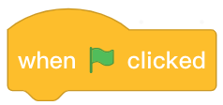

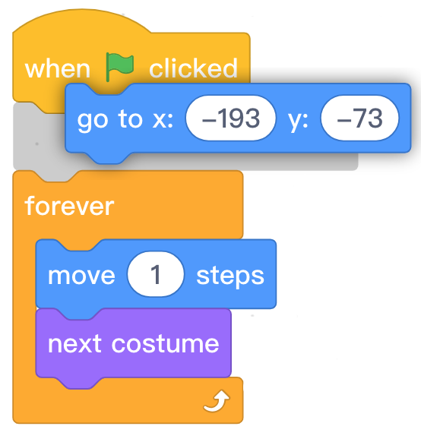
Step 3: Find and select from the Block Area. Click and drag the
block to the Script Area and attach it between the block and the
block. Change the X and Y coordinates to to position Panda on the left side of the stage.
Step 4: Click the in the Stage Area to run the program and observe Panda starting on the left side of the stage.

Slide 18
Background and Multiple Sprites

Slide 19

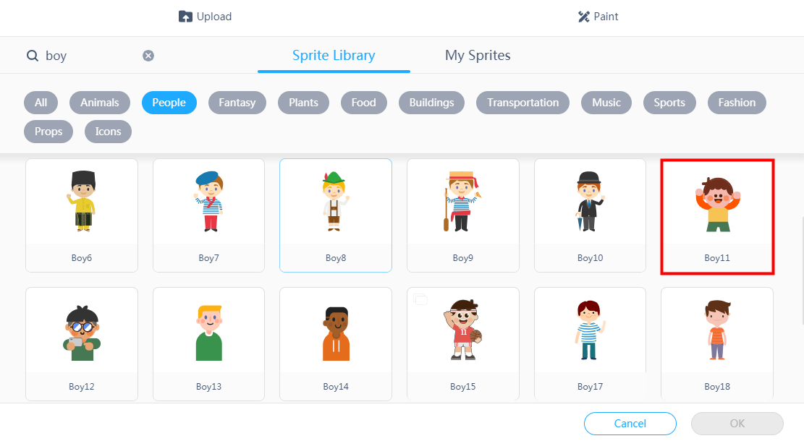
Step 1: Add the “Playground” background to the program.
Step 2: Select the Sprites tab, click the button. Search “Boy” in the sprite library, select “Boy11” and click “OK”.

Slide 20
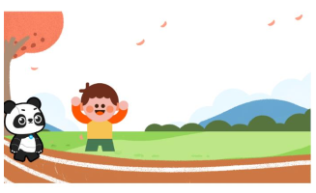
Step 3: In the Stage Area, click and drag the “Boy11” sprite to the position shown in this example:
Step 4: Select “Boy11” in the Sprite tab to enter the programming interface for “Boy11”.

Slide 21
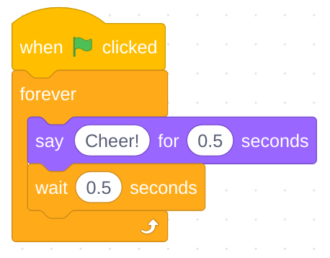
Step 5: Find and select the appropriate blocks from the Block Area to create the following program.

Slide 22
Let’s try!

Slide 23
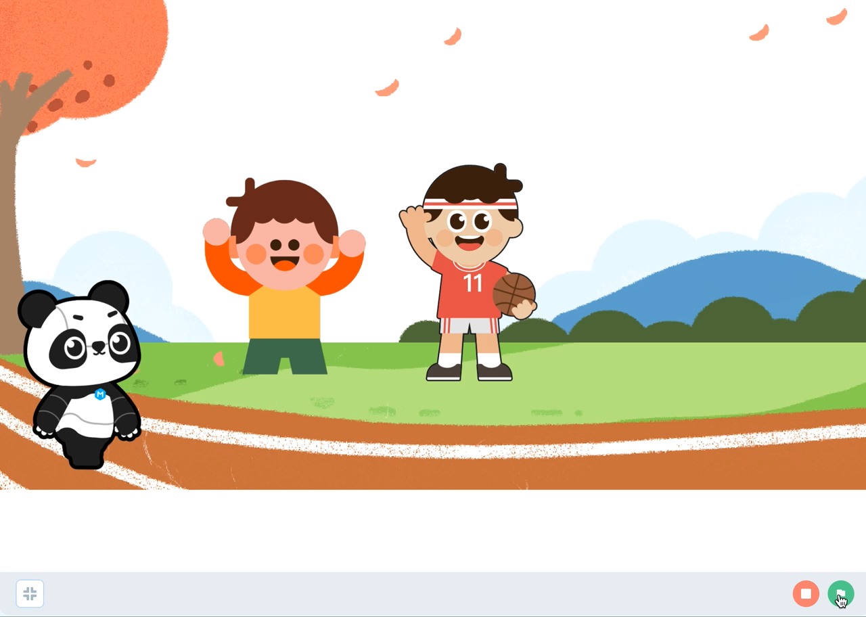

Slide 24
Independent Practice
Panda’s Race
Include “Boy15” who cheers on Panda when the is clicked.
Have “Boy15” change costumes while cheering on Panda.
Panda moves across the stage when the is clicked.
Panda is programmed to start at the left side of the stage when the is clicked.

Slide 25

Extension
Challenge students with remaining time to do one or more of the following:
Add another friend to cheer for Panda at the race.
Have Panda say something before the start of the race.
Trigger the start of the race using the space key.
Change the appearance of the “Boy11” sprite using transformations from the block area.

Slide 26
Let’s Share!

Slide 27
Review

Slide 28

1. Which block category does belong to?
A. Events
B. Control
C. Looks
D. Motion
Notes:
Answer: D

Slide 29




2. Which of the following blocks can position the sprite on specific coordinates in the stage area?
A.
B.
C.
D.
Notes:
Answer: B

Slide 30
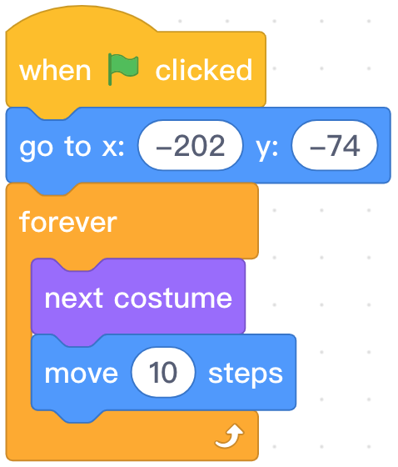
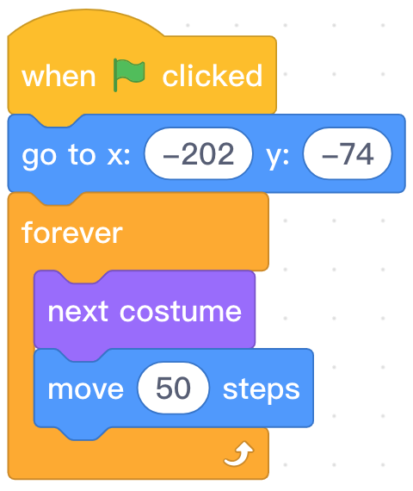
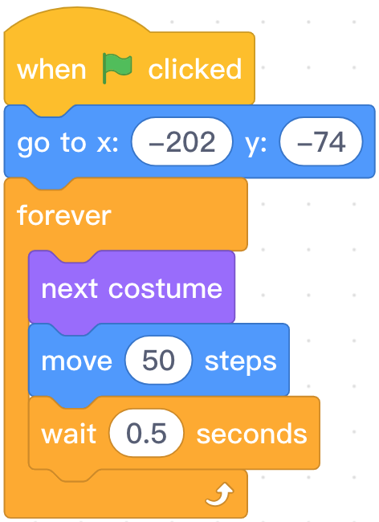
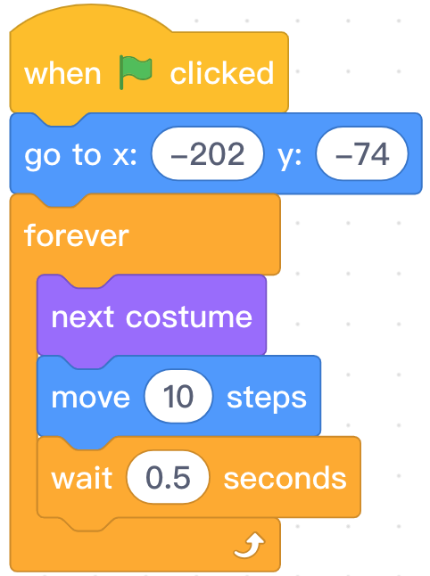
3. Which sprite runs the fastest in the following programs?
A.
B.
C.
D.
Notes:
Answer: B

Slide 31
Thank you!

